Slide 1
Machine Learning Basics
dr. Bhakti Palkar

Slide 2
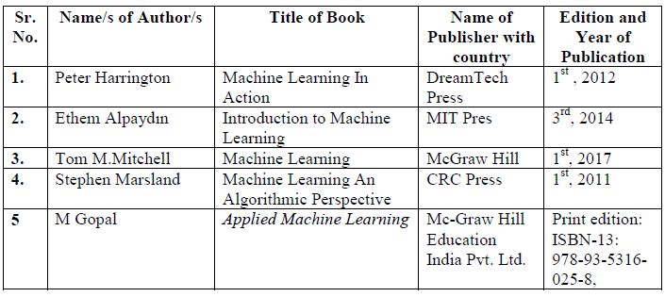
Syllabus,Text & Reference Materials
Syllabus

Slide 3
Machine Learning Basics 05 CO
1.1 Introduction to Machine Learning, Key Terminology, Types,
Introduction to applications of Machine Learning, Steps to choose the right ML algorithm, Steps in developing a Machine Learning Application.
1.2 Feature Engineering: Data Collection, Data Exploration and Profiling, data cleaning for consistent data, Introduction to data preprocessing methods for improving data quality, Data Splitting for training and evaluation sets

Slide 4

Introduction
Consider the following problem: you're building a system that performs activity recognition for fitness tracking. You might have access to the speed at which a person is moving and attempt to infer their activity based on this speed using a conditional statement
if(speed<4)
{
status=WALKING;
}

Slide 5

Introduction
You could extend this to running with another condition:
if(speed<4)
{
status=WALKING;
} else
{
status=RUNNING;
}

Slide 6

Introduction
In a final condition you could similarly detect cycling:
if(speed<4)
{
status=WALKING;
}
else if(speed<12)
{
status=RUNNING;
} else
{
status=CYCLING;
}

Slide 7

Introduction
Now consider what happens when you want to include an activity like golf? Suddenly it's less obvious how to create a rule to determine the activity.
It's extremely difficult to write a program (expressed in code) that gives you the golfing activity. So what do you do? Use machine learning to solve the problem!
// Now what?

Slide 8
Motivation for ML
It is hard to write programs for certain tasks
Human face or handwriting recognition
Playing complex games like chess
Recommending movies that a person will like
Why?
We do not ourselves know how to solve
Algorithm will be too complicated
Too many instances of the program needed (e.g., one for every user)

Slide 9
Motivation for ML
Instead of writing a program by hand, collect lots of examples that specify the correct output for a given input.
A machine learning algorithm takes these examples and produces a program that does the job.
If done right, the program works for new cases as well as the ones we trained it on.

Slide 10
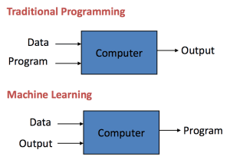
Traditional Programming / Machine Learning
Traditional Programming: Data and program is run on the computer to produce the output.
Machine Learning: Data and output is run on the computer to create a program. This program can be used in traditional programming.
Notes:
Machine learning is like farming or gardening. Seeds is the algorithms,nutrients is the data, the gardner is you and plants is the programs.

Slide 11

Machine Learning definition
Arthur Samuel (1959):
Field of study that gives computers the ability to learn without being explicitly programmed.
Tom Mitchell (1998):
Well-posed Learning Problem: A computer program is said to learn from experience E with respect to some task T and some performance measure P, if its performance on T, as measured by P, improves with experience E.

Slide 12
For example:
Your spam filter is a Machine Learning program ,
given examples of spam emails (e.g., flagged by users) and examples of regular (nonspam, also called “ham”) emails, can learn to flag spam.
The examples that the system uses to learn are called the training set. Each training example is called a training instance (or sample).
In this case, the task T is to flag spam for new emails, the experience E is the training data, and the performance measure P needs to be defined;
for example, you can use the ratio of correctly classified emails. This particular performance measure is called accuracy, and it is often used in classification tasks.

Slide 13
Why Use Machine Learning?
Consider how you would write a spam filter using traditional programming techniques
First you would consider what spam typically looks like. You might notice that some words or phrases (such as “4U,” “credit card,” “free,” and “amazing”) tend to come up a lot in the subject line. Perhaps you would also notice a few other patterns in the sender’s name, the email’s body, and other parts of the email.
You would write a detection algorithm for each of the patterns that you noticed, and your program would flag emails as spam if a number of these patterns were detected.
You would test your program and repeat steps 1 and 2 until it was good enough to launch.

Slide 14
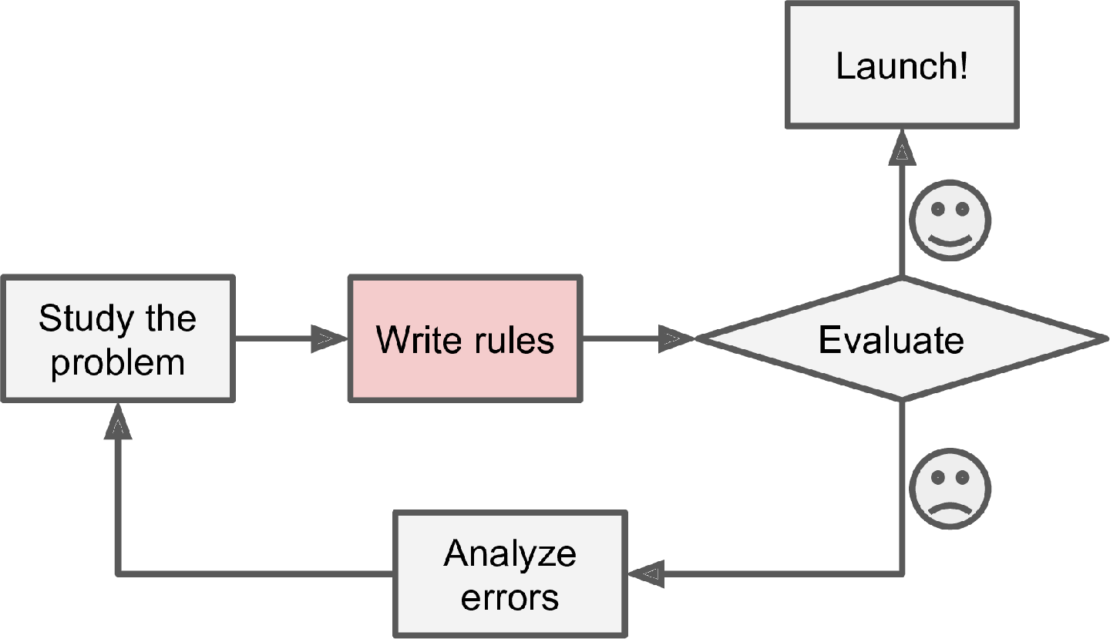
The traditional approach

Slide 15
Since the problem is difficult, your program will likely become a long list of complex rules—pretty hard to maintain.
In contrast, a spam filter based on Machine Learning techniques automatically learns which words and phrases are good predictors of spam by detecting unusually frequent patterns of words in the spam examples compared to the ham examples. The program is much shorter, easier to maintain, and most likely more accurate.
What if spammers notice that all their emails containing “4U” are blocked? They might start writing “For U” instead.
A spam filter using traditional programming techniques would need to be updated to flag “For U” emails. If spammers keep working around your spam filter, you will need to keep writing new rules forever.
In contrast, a spam filter based on Machine Learning techniques automatically notices that “For U” has become unusually frequent in spam flagged by users, and it starts flagging them without your intervention

Slide 16
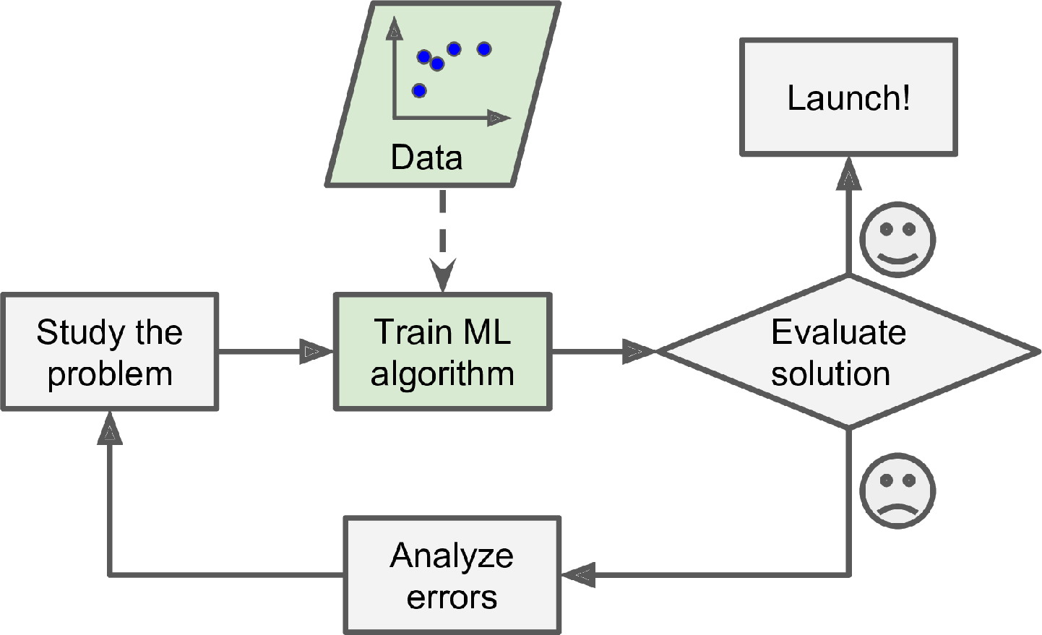
The Machine Learning approach

Slide 17
Another area where Machine Learning shines is for problems that either are too complex for traditional approaches or have no known algorithm.
For example, consider speech recognition. Say you want to start simple and write a program capable of distinguishing the words “one” and “two.”
You might notice that the word “two” starts with a high-pitch sound (“T”), so you could hardcode an algorithm that measures high-pitch sound intensity and use that to distinguish ones and twos⁠.
but obviously this technique will not scale to thousands of words spoken by millions of very different people in noisy environments and in dozens of languages.
The best solution (at least today) is to write an algorithm that learns by itself, given many example recordings for each word.

Slide 18
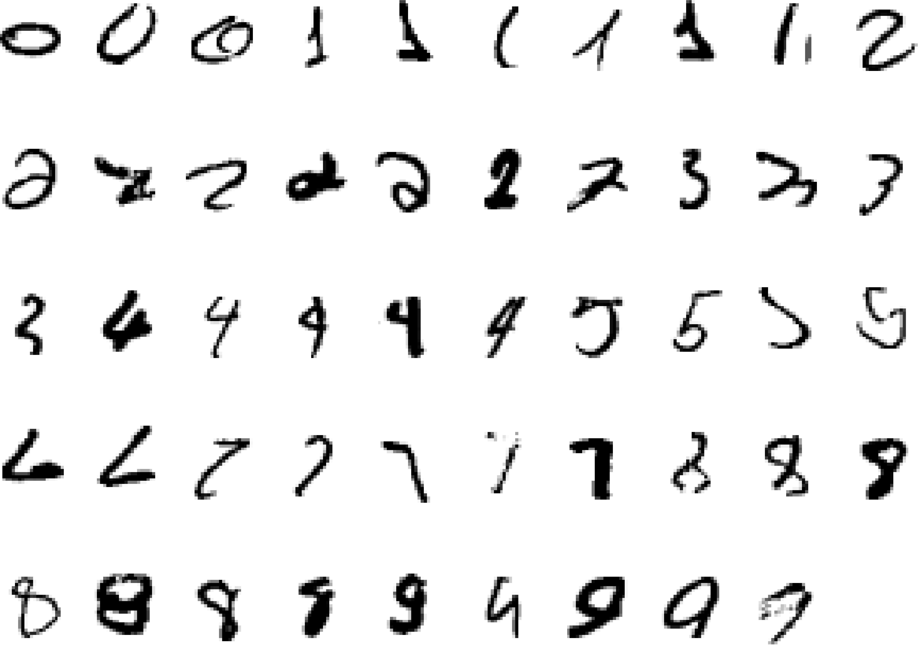
A classic example of a task that requires machine learning: It is very hard to say what makes a 2

Slide 19
Finally, Machine Learning can help humans learn. ML algorithms can be inspected to see what they have learned (although for some algorithms this can be tricky).
For instance, once a spam filter has been trained on enough spam, it can easily be inspected to reveal the list of words and combinations of words that it believes are the best predictors of spam.
Sometimes this will reveal unsuspected correlations or new trends, and thereby lead to a better understanding of the problem.
Applying ML techniques to dig into large amounts of data can help discover patterns that were not immediately apparent. This is called data mining.

Slide 20
Key Concept of Machine Learning
Important aspects of “Learning from Experience” embedded into ML are:
Remembering, adapting
Generalizing

Slide 21
To summarize, Machine Learning is great for:
Problems for which existing solutions require a lot of fine-tuning or long lists of rules: one Machine Learning algorithm can often simplify code and perform better than the traditional approach.
Complex problems for which using a traditional approach yields no good solution: the best Machine Learning techniques can perhaps find a solution.
Fluctuating environments: a Machine Learning system can adapt to new data.
Getting insights about complex problems and large amounts of data.

Slide 22
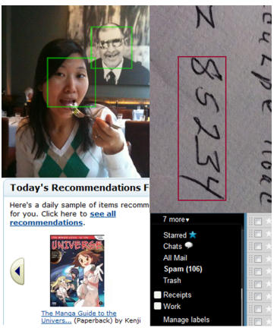

Slide 23
Applications
Recognizing patterns
Facial identities or facial expressions
Handwritten or spoken words
Medical images
Generating patterns
Generating images or motion sequences
Recognizing anomalies
Unusual sequences of credit card transactions
Unusual patterns of sensor readings in a nuclear power plant or unusual sound in your car engine.
Prediction
Future stock prices or currency exchange rates

Slide 24
Web-based applications
The web contains a lot of data. Tasks with very big datasets often use machine learning
Spam filtering, fraud detection
The enemy adapts so we must adapt too.
Recommendation systems
Need to adapt to millions of individuals. E.g., Youtube video, Netflix movies recommendation
Information retrieval
Find documents or images with similar content.
Data Visualization
Display a huge database in a revealing way

Slide 25
Key Elements of Machine Learning
Every machine learning algorithm has three components:
Representation: how to represent knowledge. Examples include decision trees, sets of rules, instances, graphical models, neural networks, support vector machines, model ensembles and others.
Evaluation: the way to evaluate candidate programs (hypotheses). Examples include accuracy, prediction and recall, squared error, likelihood, posterior probability, cost, margin, entropy k-L divergence and others.
Optimization: the way candidate programs are generated known as the search process. For example combinatorial optimization, convex optimization, constrained optimization.

Slide 27



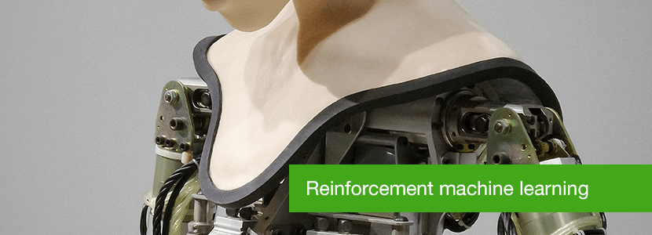
Types of ML

Slide 28
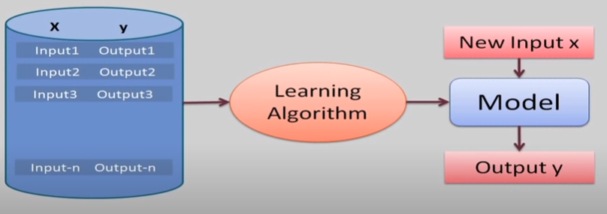
Supervised Machine Learning Algorithms

Slide 29
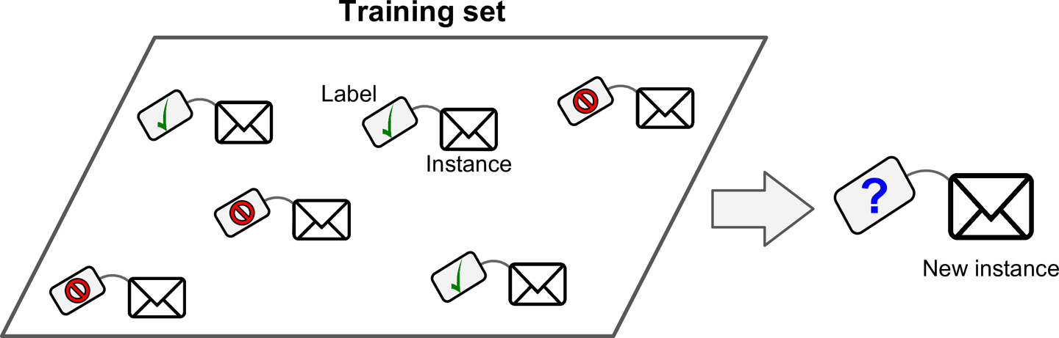
Supervised Machine Learning Algorithms
Classification is the process where incoming data is labelled based on past data samples and manually trains the algorithm to recognize certain types of objects and categorize them accordingly.

Slide 30
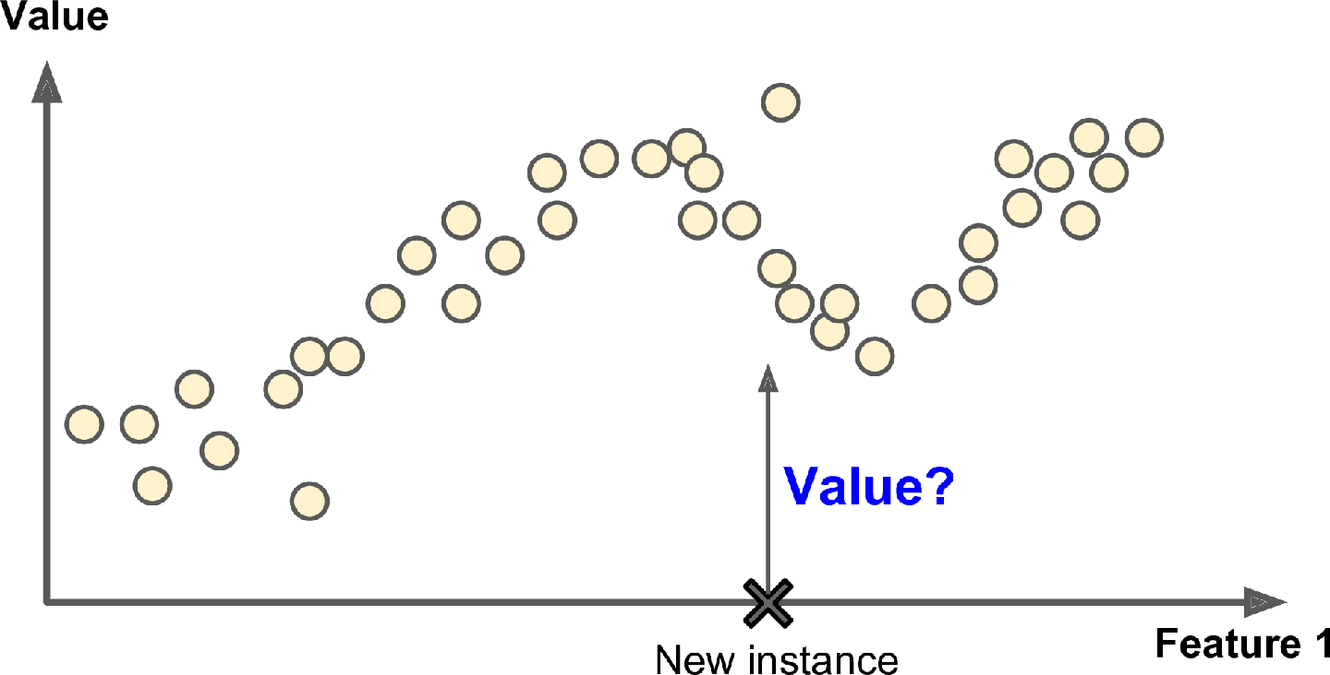
Supervised Machine Learning Algorithms
Regression is the process of identifying patterns and calculating the predictions of continuous outcomes. The system has to understand the numbers, their values, grouping (for example, heights and widths), etc.

Slide 31
Widely used supervised algorithms
Linear Regression
Logistical Regression
Random Forest
Gradient Boosted Trees
Support Vector Machines (SVM)
Neural Networks
Decision Trees
Naive Bayes
Nearest Neighbour

Slide 32
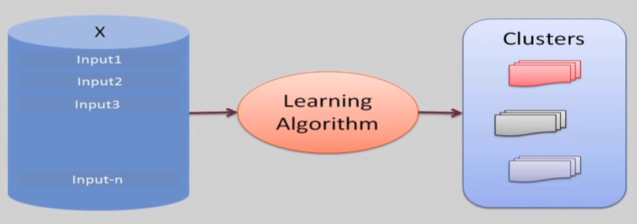
Unsupervised Machine Learning Algorithms
Notes:
The machine learning algorithm studies data to identify patterns.
There is no answer key or human operator to provide instruction.
The machine determines the correlations and relationships by analysing available data.
The algorithm tries to organise that data in some way to describe its structure.
This might mean grouping the data into clusters or arranging it in a way that looks more organised.

Slide 33
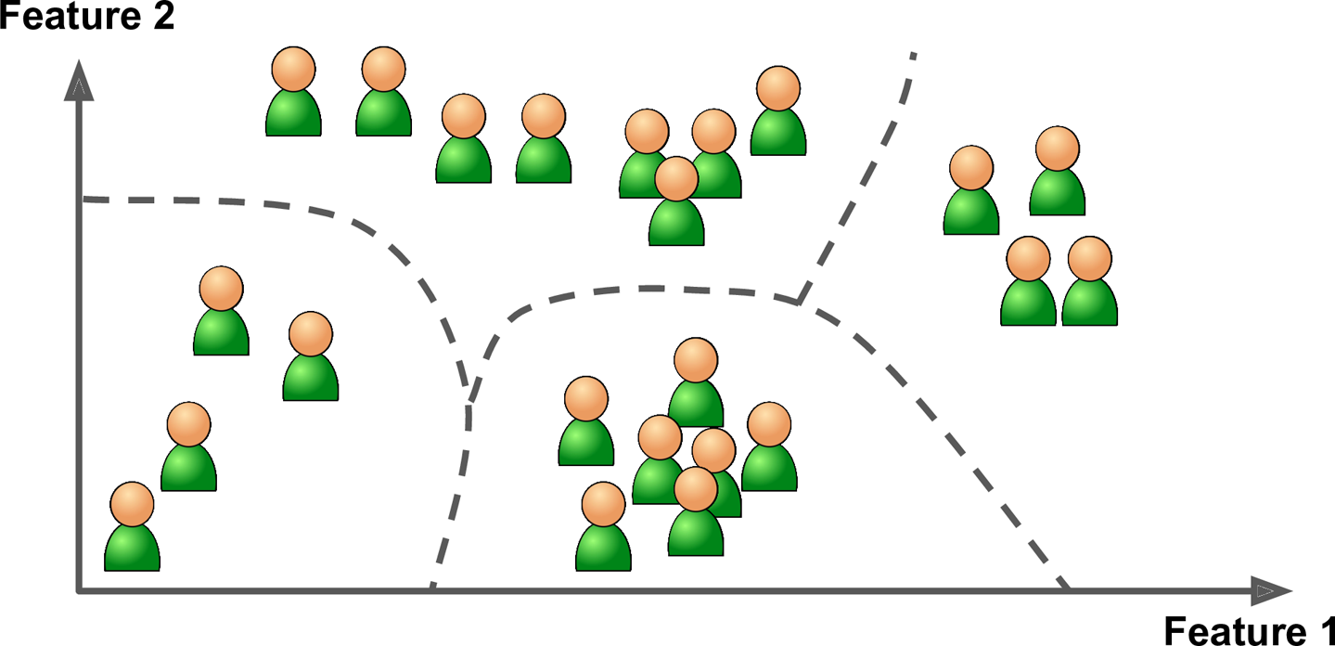
Unsupervised Machine Learning Algorithms
Clustering: Clustering involves grouping sets of similar data (based on defined criteria). It’s useful for segmenting data into several groups and performing analysis on each data set to find patterns.
Dimension reduction: Dimension reduction reduces the number of variables being considered to find the exact information required.

Slide 34
Widely used Un-supervised algorithms
k-means clustering
t-SNE (t-Distributed Stochastic Neighbour Embedding)
PCA (Principal Component Analysis)
Association rule

Slide 35
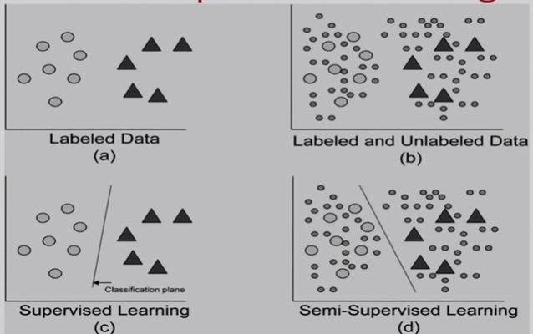
Semi-supervised machine-learning algorithm
A semi-supervised machine-learning algorithm uses a limited set of labelled sample data to train itself.
The limitation results in a partially trained model that later gets the task to label the unlabelled data.
Due to the limitations of the sample data set, the results are considered pseudo-labelled data.
Finally, labelled and pseudo-labelled data sets are combined.
Semi-supervised learning uses the classification process to identify data assets and the clustering process to group it into distinct parts.

Slide 36
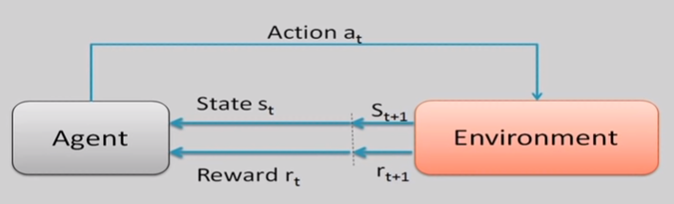
Reinforcement learning algorithms
Reinforced ML uses the technique called exploration/exploitation.
The action takes place, the consequences are observed, and the next action considers the results of the first action.
Notes:
Reinforcement learning is all about developing a self-sustained system that, throughout contiguous sequences of tries and fails, improves itself based on the combination of labeled data and interactions with the incoming data.
In the centre of reinforcement learning algorithms are reward signals that occur upon performing specific tasks. In a way, reward signals are serving as a navigation tool for the reinforcement algorithms. They give it an understanding of right and wrong course of action.

Slide 37
Reinforcement learning algorithms
Positive reward signal encourages continuing performance a particular sequence of action
Negative reward signal penalizes for performing certain activities and urges to correct the algorithm to stop getting penalties.
However, the function of the reward signal may vary depending on the nature of the information. Thus reward signals may be further classified depending on the requirements of the operation. Overall, the system tries to maximize positive rewards and minimize the negatives.

Slide 38
Reinforcement learning algorithms
For example, many robots implement Reinforcement Learning algorithms to learn how to walk. DeepMind’s AlphaGo program is also a good example of Reinforcement Learning: it made the headlines in May 2017 when it beat the world champion Ke Jie at the game of Go.
It learned its winning policy by analyzing millions of games, and then playing many games against itself. Note that learning was turned off during the games against the champion; AlphaGo was just applying the policy it had learned.

Slide 39
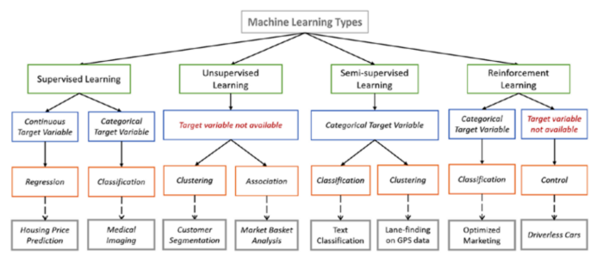
Types of Learning

Slide 40
Simple Steps to Choose Best Machine Learning Algorithm
Understand Your Problem : Begin by gaining a deep understanding on the problem you are trying to solve. What is your goal? What is the problem all about classification, regression , clustering, or something else? What kind of data you are working with?
Process the Data: Ensure that your data is in the right format for your chosen algorithm. Process and prepare your data by cleaning, Clustering, Regression.
Exploration of Data: Conduct data analysis to gain insights into your data. Visualizations and statistics helps you to understand the relationships within your data.
Metrics Evaluation: Decide on the metrics that will measure the success of model. You must choose the metric that should align with your problem.
Simple models: One should begin with the simple easy-to-learn algorithms. For classification, try regression, decision tree. Simple model provides a baseline for comparison.

Slide 41
Simple Steps to Choose Best Machine Learning Algorithm
6. Use Multiple Algorithms: Try to use multiple algorithms to check that one performs on your dataset. That may include:
Decision Trees
Gradient Boosting(XGBoost, LightGBM)
Random Forest
k-Neasrest Neighbors(KNN)
Naive Bayes
Support Vector Machines(SVM)
Neural Networks(Deep Learning)

Slide 42
Simple Steps to Choose Best Machine Learning Algorithm
Hyperparameter Tuning: Grid Search and Random Search can helps with adjusting parameters choose algorithm that find best combination.
Cross- Validation: Use cross- validation to get assess the performance of your models. This helps prevent overfiting .
Comparing Results: Evaluate the models’s performance by using the metrics evaluation. Compare their performance and choose that best one that align with problem’s goal.
Consider Model Complexity: Balance complexity of model and their performance. Compare their performance and choose that one best algorithm to generalize better.

Slide 43
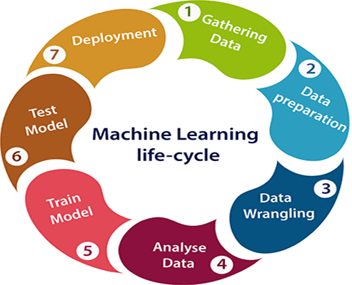
Steps in developing a Machine Learning Application

Slide 44
1. Gathering Data
In this step, we need to identify the different data sources, as data can be collected from various sources such as files, database, internet, or mobile devices. It is one of the most important steps of the life cycle. The quantity and quality of the collected data will determine the efficiency of the output. The more will be the data, the more accurate will be the prediction.
This step includes the below tasks:
Identify various data sources
Collect data
Integrate the data obtained from different sources
By performing the above task, we get a coherent set of data, also called as a dataset. It will be used in further steps.

Slide 45
2. Data preparation
After collecting the data, we need to prepare it for further steps. Data preparation is a step where we put our data into a suitable place and prepare it to use in our machine learning training.
In this step, first, we put all data together, and then randomize the ordering of data.
Data exploration: It is used to understand the nature of data that we have to work with. We need to understand the characteristics, format, and quality of data. A better understanding of data leads to an effective outcome. In this, we find Correlations, general trends, and outliers.

Slide 46
3. Data Wrangling
Data wrangling is the process of cleaning and converting raw data into a useable format. It is the process of cleaning the data, selecting the variable to use, and transforming the data in a proper format to make it more suitable for analysis in the next step. It is one of the most important steps of the complete process. Cleaning of data is required to address the quality issues.
It is not necessary that data we have collected is always of our use as some of the data may not be useful. In real-world applications, collected data may have various issues, including:
Missing Values
Duplicate data
Invalid data
Noise
So, we use various filtering techniques to clean the data.
It is mandatory to detect and remove the above issues because it can negatively affect the quality of the outcome.

Slide 47
4. Data Analysis
This is looking at the data from the previous task. This could be as simple as looking at the data You can also look at the data to see if you can recognize any patterns or if there’s anything obvious, such as a few data points that are vastly different from the rest of the set. \
Plotting data in one, two, or three dimensions can also help.
But most of the time you’ll have more than three features, and you can’t easily plot the data across all features at one time. You could, however, use some advanced methods

Slide 48
5. Train Model
Now the next step is to train the model, in this step we train our model to improve its performance for better outcome of the problem.
We use datasets to train the model using various machine learning algorithms. Training a model is required so that it can understand the various patterns, rules, and, features.

Slide 49
6. Test Model
Once our machine learning model has been trained on a given dataset, then we test the model. In this step, we check for the accuracy of our model by providing a test dataset to it.
Testing the model determines the percentage accuracy of the model as per the requirement of project or problem.

Slide 50
7. Deployment
The last step of machine learning life cycle is deployment, where we deploy the model in the real-world system.
If the above-prepared model is producing an accurate result as per our requirement with acceptable speed, then we deploy the model in the real system. But before deploying the project, we will check whether it is improving its performance using available data or not.

